Slide 1
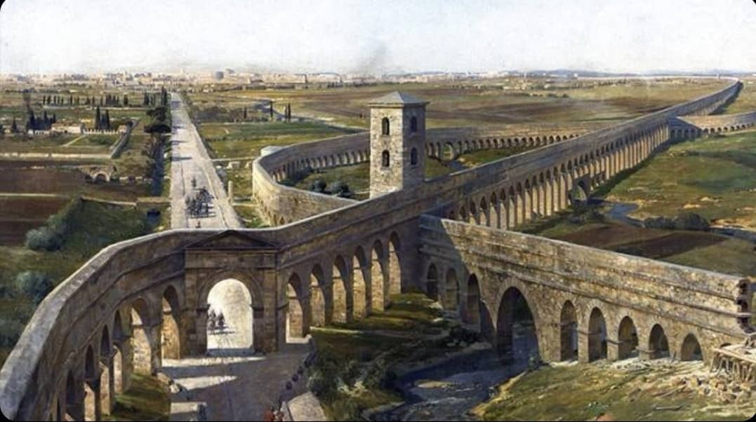
Hedgehog Rock

Slide 2
University of Science and Technology Bannu
Deep Learning
Lesson 3
May 13, 2024

Slide 3
Learning Objectives
Bias VS Threshold
Network Topology
Activation Functions/Transfer Functions

Slide 4
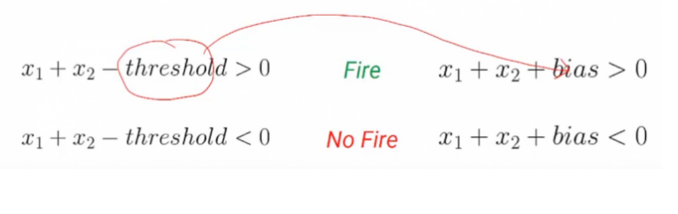

Threshold Vs Bias
If you compare a quantity against that value, it's a threshold.
Threshold is the value which is used for comparison, when it is moved from right hand side to the left-hand side than it becomes bias.
$output=\left\{\begin{aligned}0, if \sum_{j}{x_{j}w_{j}} ≤ threshold \\ 1, if \sum_{j}{x_{j}w_{j}} >threshold\end{aligned}\right.$
$output=\left\{\begin{aligned}0, if \sum_{j}{x_{j}w_{j}+\left(−threshold\right)<0} \\ 1, if \sum_{j}{x_{j}w_{j}+(−threshold}) >0\end{aligned}\right.$
The –Ve Threshold is called Bias

Slide 6
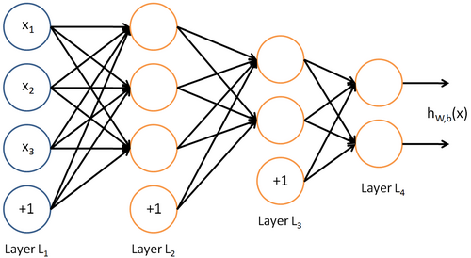
Bias
A bias unit is an "extra" neuron added to each pre-output layer that stores the value of 1.

Slide 7
Example
Let’s have a look at an example to understand this better.
Suppose today is a college party and you have to decide whether you should go to the party or not based on some input conditions such as
Is the weather good?
Is the venue nearby?
Is there Free Biryani offer?
So, if the weather is good then it will be presented with a value of 1, otherwise 0. Similarly, if the venue is near it will be represented by 1, otherwise 0. And similarly for your crush(Biryani) is available.

Slide 8
Example
We can assign a weight of 3 to the weather, a weight of 2 to the venue, and a weight of 6 to the crush.
Now if the sum of all these three factors that is weather, venue, and crush is greater than a threshold of 5, then you can decide to go to the party otherwise not.
X1= is the whether is good?
3
X2= is the venue is near?
2
Should go to the Party?
6
X3= is there is free Biryani?
-5
X0= 1

Slide 9
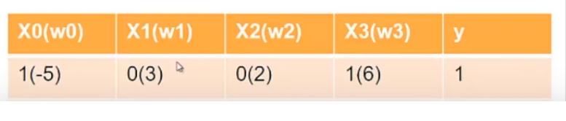
Example
So for example, we have taken initially the condition where crush is more important than the weather or the venue itself.
Note: X0 is the bias value

Slide 10
Example
Let’s imagine a different scenario now.
Imagine you’re sick today and no matter what you will not attend the party then this situation can be represented by assigning equal weight to weather, venue, and crush with the threshold of 4.
X1= is the whether is good?
1
X2= is the venue is near?
1
Should go to the Party?
1
X3= is there is free Biryani?
-4
X0= 1

Slide 11
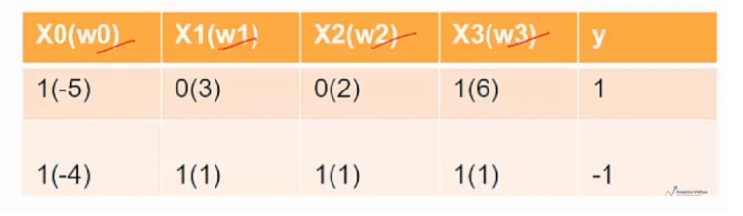
Example

Slide 12
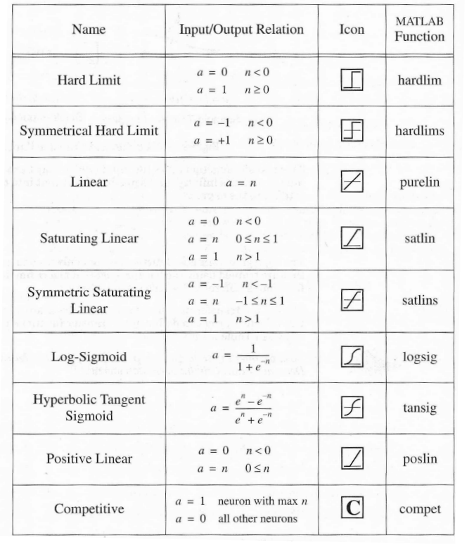
Activation Functions
Also called the squashing function as it limits
the amplitude of the output of the neuron.
Many types of activations functions are used:
1. Linear Function
2. Sigmoid Function
3. Tanh Function
4. RELU Function
5. Soft Max Function

Slide 13

Different Neural Network Topology

Slide 14
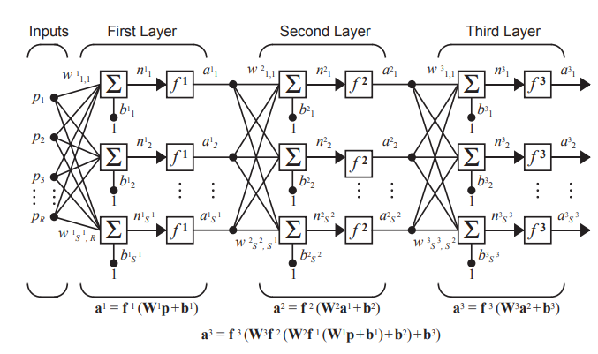
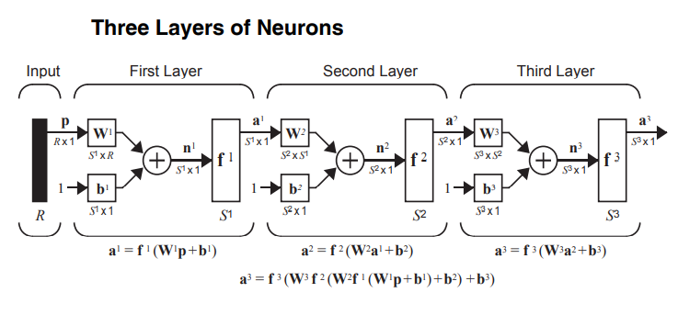
Three Layer Neuron

Slide 15
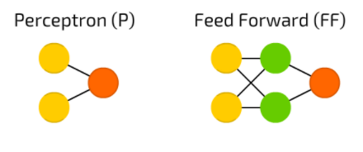
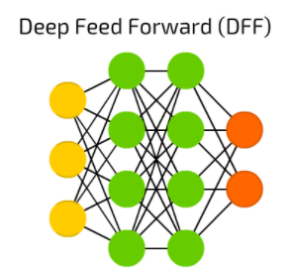

Slide 16
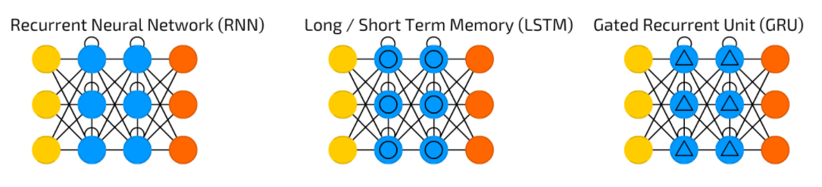

Slide 17
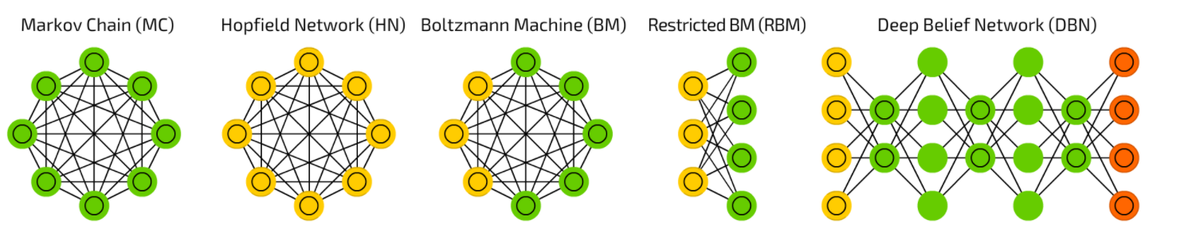

Slide 18
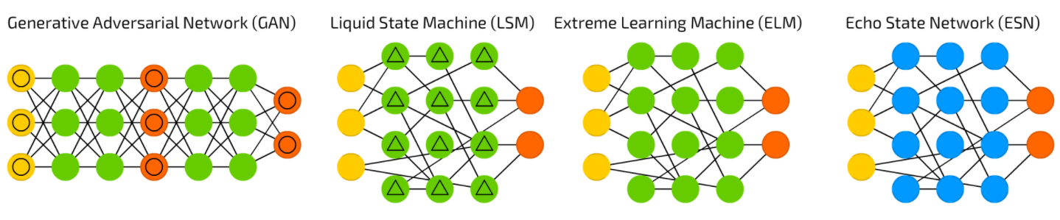

Slide 19



Slide 20

Kahoot Quiz
Go to www.kahoot.it & enter
Game PIN

